Slide 1


Welcome to the South West Region Money Advice Liaison Group Meeting
3rd October 2019

Slide 2


Who We Are
Notes:
WHO WE ARE – OVERVIEW OF GROUP COMPANIES
As you will see from this image, South West Water is part Pennon Group plc based in Exeter. Pennon Group is listed on the London Stock Exchange.
South West Water is licensed to provide, since the industry was privatised in 1989, water and sewerage services to customers in Devon, Cornwall and small areas of Dorset and Somerset.
Our sister company, Viridor, based in Taunton, is one of the UK’s leading recycling, renewable energy and waste management companies. Although their headquarters are in Somerset, they have landfill sites and recycling stations all over the UK, and work with more than 90 local authorities and thousands of private customers. country.

Slide 3


Covers Bournemouth, which extends to Poole in the west, Beaulieu in the east and Salisbury in the north
We supply over 450,000 customers
Acquired by Pennon in April 2015
We have received the Customer Service Excellence Award for the 14th year in succession
Covers Devon and Cornwall as well as parts of Dorset and Somerset
We supply over 1.7 million residents and around 5 million tourists each year
We have the highest percentage of metered customer in the UK
We are the only company to achieve successive fast track status for our 5 year business plan.
As a group, OFWAT fast-tracked our PR19 submission stating that we are
“setting the standard for others to reach”
3
Notes:
From 2017, South West Water and Bournemouth Water have operated under the same license and have benefitted from sharing best practice across a number of areas.

Slide 4
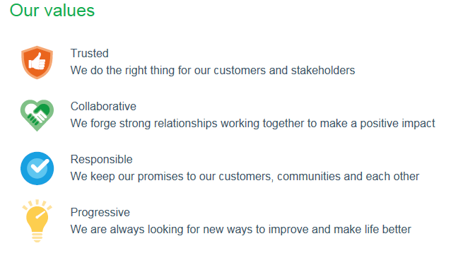

Slide 5
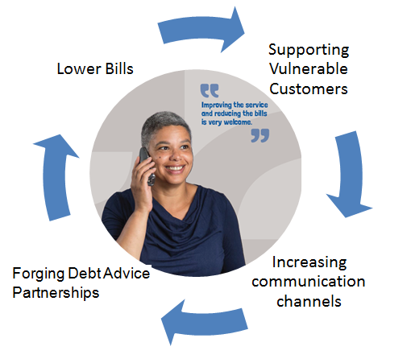
Our Aims:
“Placing the customers at the very heart of everything we do”
Ensure the customer is on a payment method and tariff to fit their needs
Explore what additional services or schemes we can offer to help with their situation
Proactively engage customers
Offer affordability advice at every opportunity
Make an affordability assessment the default choice for all
Expanding key partnerships with trusted Debt Advice organisations to ensure our vulnerable customers can access help and support at any time

Slide 6
Affordability Challenges Driven by Various Factors
Environmental Considerations
IVAs increased by 12.5%
Individual insolvency increases by 6.7% year on year
Stepchange report has an increase of 15.8% (2012) to 24.2% (2016) in water debt consumer referrals
Stepchange also report 60% of referrals are now in the <40 years old category
CAB supported 74,736 clients in 2016. 55% was in regards to WaterSure and social tariffs
Consumers applying for universal credit are waiting up to 24 weeks for benefit
1 in 2 consumers seeking debt advice have a diagnosed mental health condition
New banking regulations on overdraft interest fees
9.4% increase in food banks in counties of Devon and Cornwall
Debt still funding 20% of consumer spending
Rising interest rates for the first time in 10 years
Slow recovery of the economy
Brexit reservations and indecisions
Average Monthly income is £46 less than 2012

Slide 7
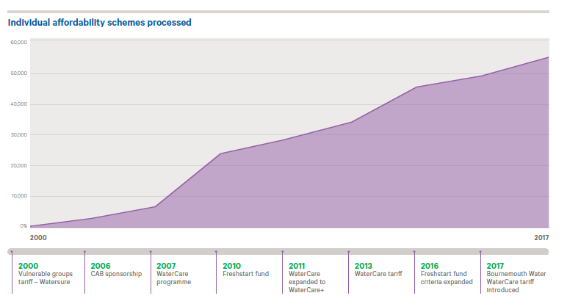
How many people have we helped so far?

Slide 8
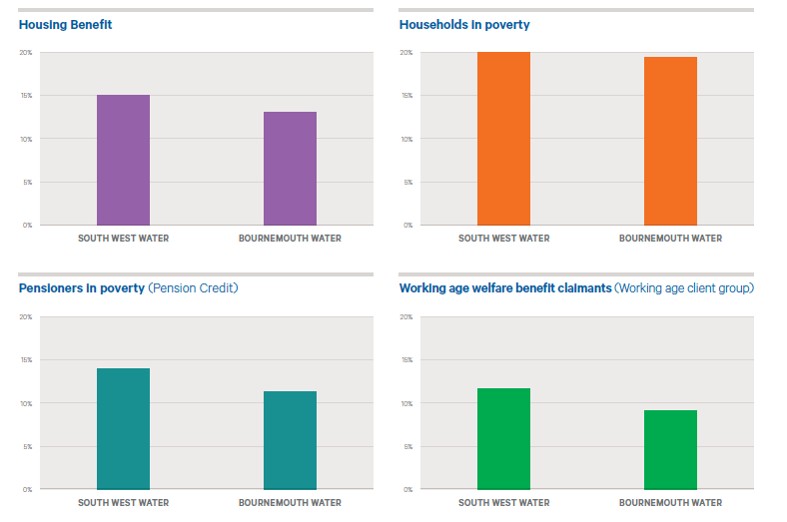
What does affordability look like for our area?

Slide 9
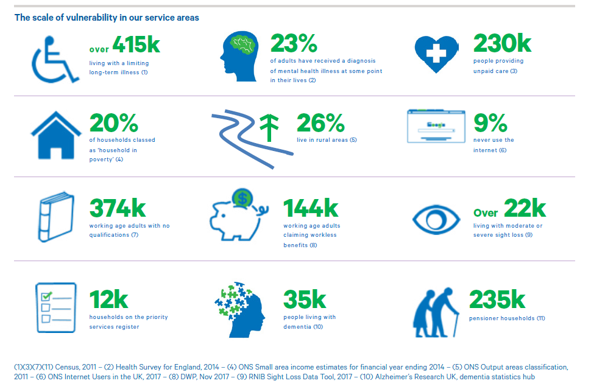
The scale of vulnerability in our region

Slide 10
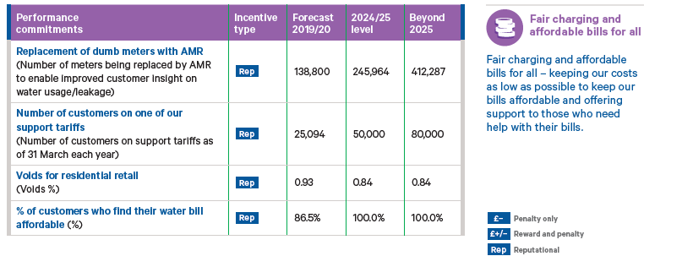
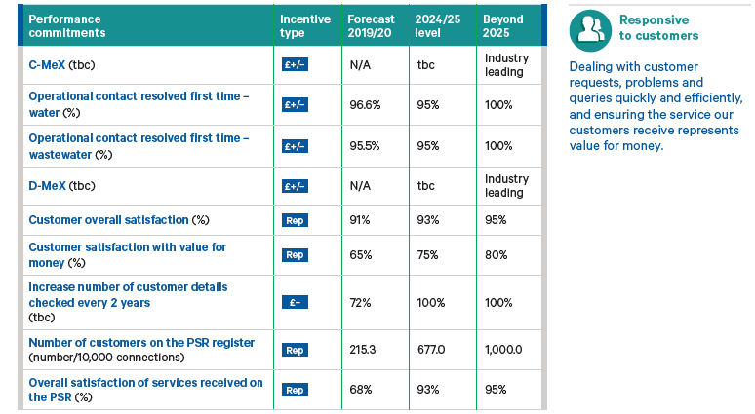
What targets have we set for ourselves by 2025?

Slide 11
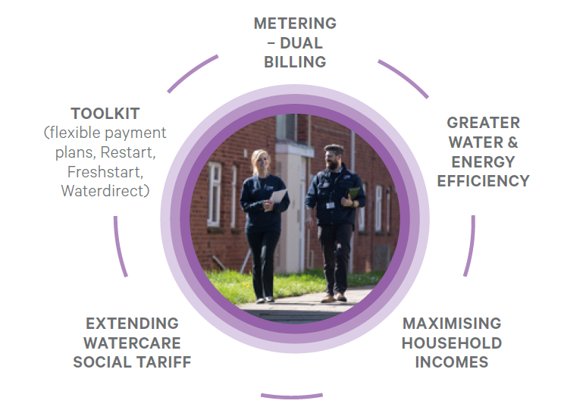
How we will achieve this?

Slide 12
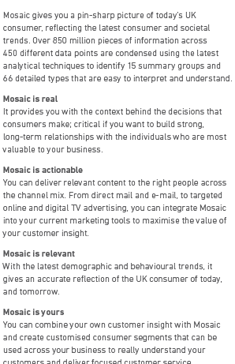
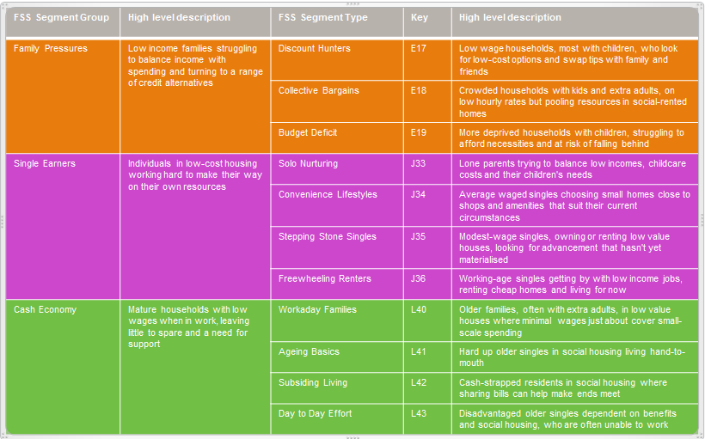
Treating customers as individuals, Mosaic

Slide 13
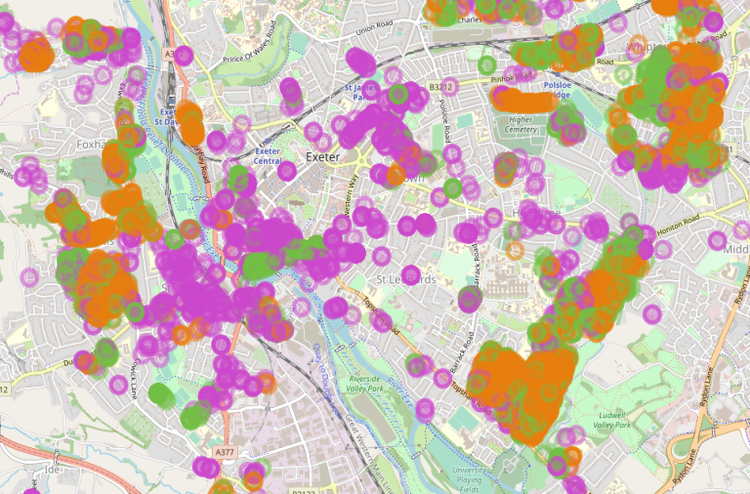
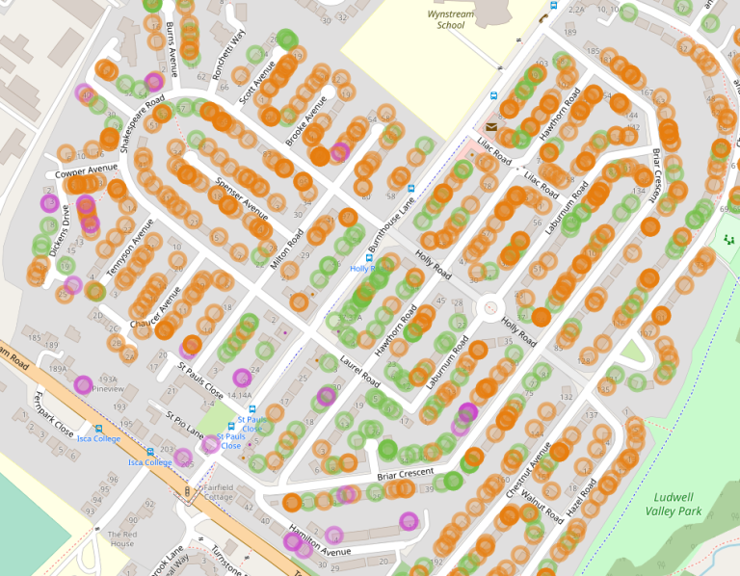
Customer segmentation by region, area & street
Cross reference with debtors in our region
Identify localities with similar demographics
Offer targeted & appropriate customer affordability solutions
Scope to work with local partner advice agencies in these areas
Communicate by customers preferred contact method

Slide 14
Customer Mentoring Outreach

Slide 15
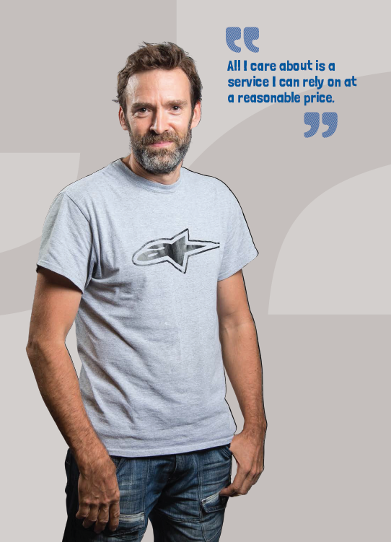
SWW Support Tariffs
Watersure
WaterCare
  Reduced banded tariff for customers on low incomes
WaterCare+
  Benefit checks, water saving advice & home visits
Restart
  Phased debt write off in line with regular customer payments
FreshStart
  Trust fund offering grants to customers dealing with an extraordinary life event

Slide 16

Expanding our Advice Network
We aim to have free local debt advice contacts in all areas
Immediate customer referral
Assist with paperwork
Flag potential SWW affordability solutions

Slide 17
Thank you
Any Questions

