Slide 1
Overview of credit unions

Slide 2
What is a credit union?
Deposit-taking financial co-operative business
Membership governed by common bond
Fully regulated by PRA and FCA – FSCS protection to £85,000
Safe savings – ordinary deposits, ISAs, payroll savings
Affordable credit – capped interest – small, short term loans upwards
Transactional payment services
Plastic cards & budgeting services
Mortgages

Slide 3
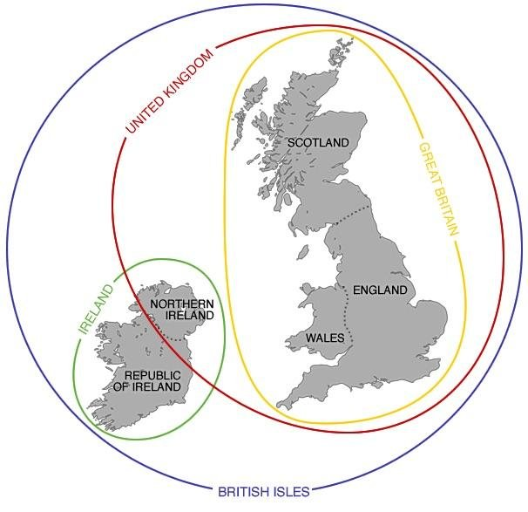
Credit Unions in Great Britain
307 credit unions
From 200 to over 40,000 members
1,290,000 people (137,000 juniors)
Penetration less than 2% in Britain.
£1.5 billion in assets
Why so small?
Legislation in place from 1979 but restricted and little prudential regulation & deposit protection
Flawed development model in 1980s / 90s – focus on anti-poverty, use of volunteers and investment in development workers, not CU’s.
Relative success of ‘Community’ vs ‘Employer’ Credit Union model
Competitive market place with insufficiently attractive product offering

Slide 4
Lender
APR
Cost of £300
(1 month)
Cost of £1000
(12 months)
1,509%
£72
N/A
299.3%
N/A
£872
42.6%
(or less)
£9
£191

Slide 5
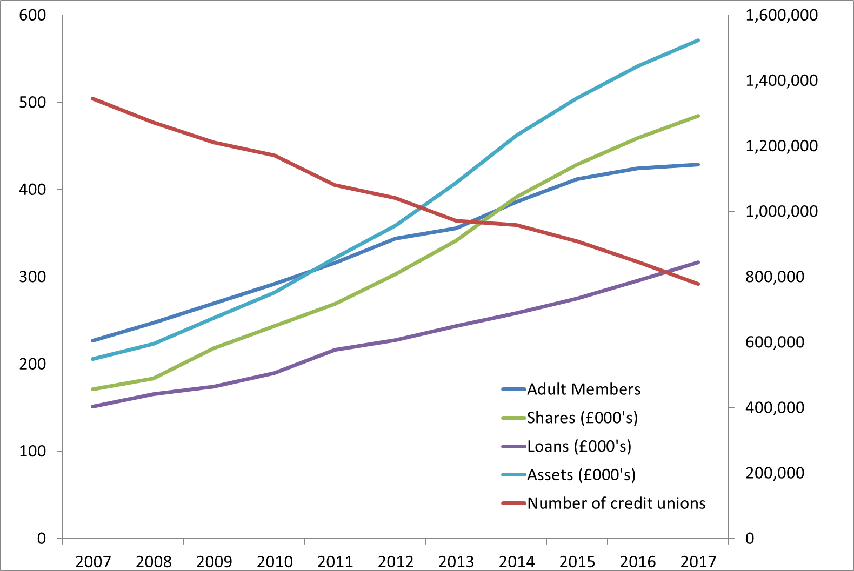
British Credit Union Growth 2007-17

Slide 6
Opportunities & challenges
Lending
Digital expectations
FinTech
Employer’s & financial capability
Competition

Slide 7
Lack of savings & associated debt
1 in 4 people lose sleep due to money worries – CIPD
26% of working age adults have no savings & further 29% have less than £1,000 / 40% less than £100 – Money Advice Service
Consumer debt at record levels
3m people behind on essential household bills - StepChange

Slide 8
Fair banking

Slide 9
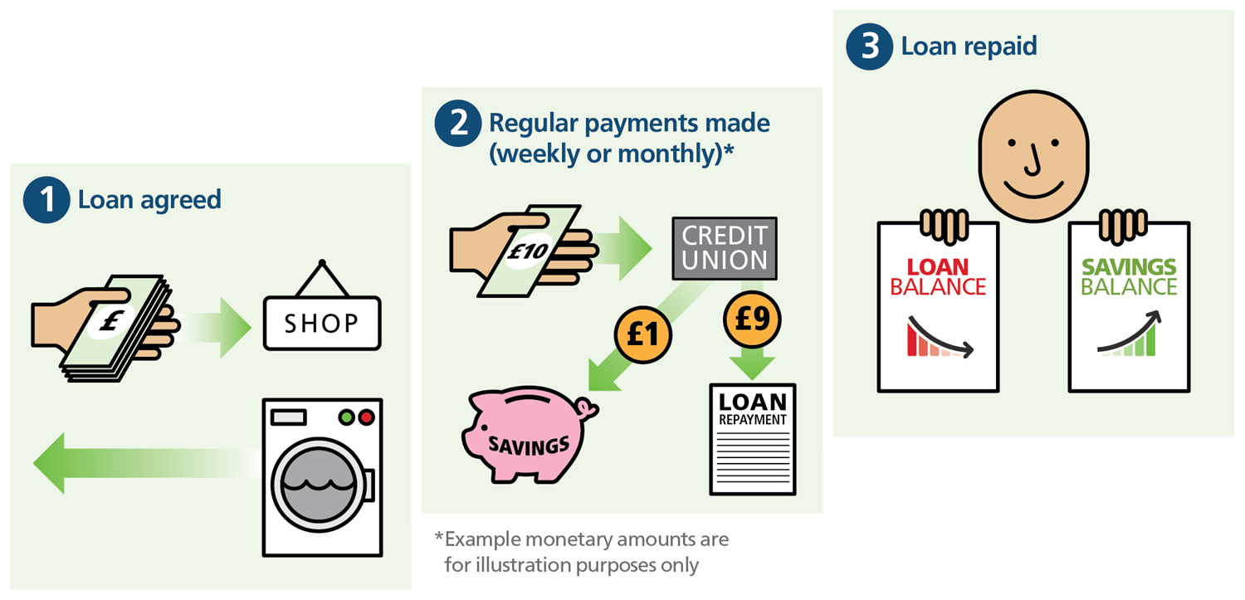
Save as you Borrow mechanism

Slide 10
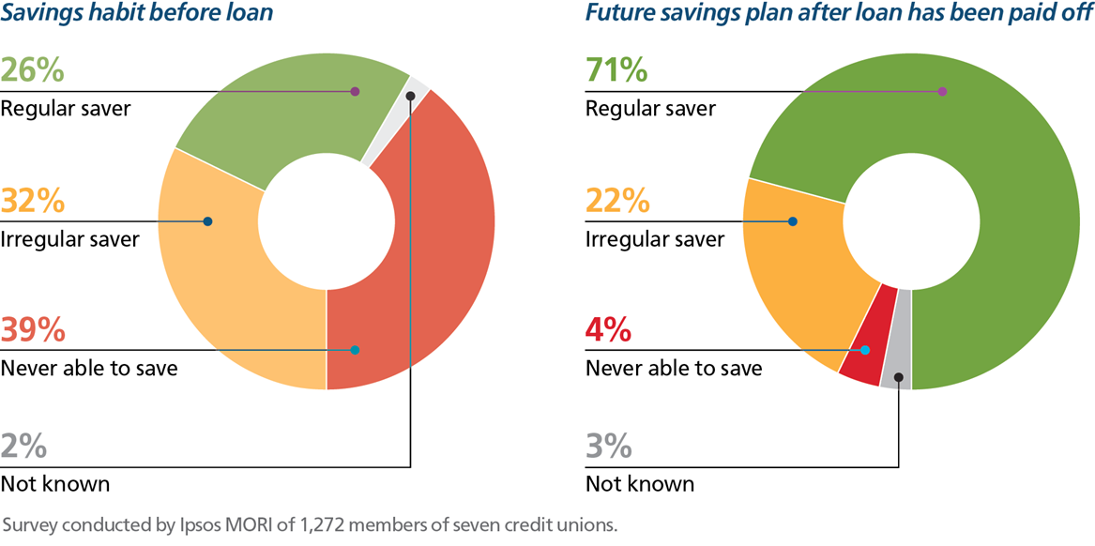
Effect on savings habits

