Slide 1
Towering above the competition

Slide 2
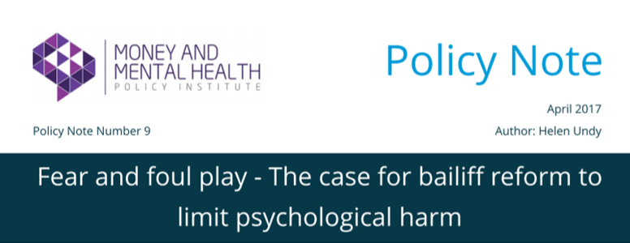
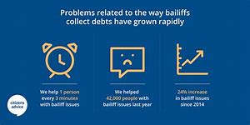
Debunking Myths : Bailiffs , Enforcement Agents here
“Bailiff reforms “not working”, say charities”

Slide 3
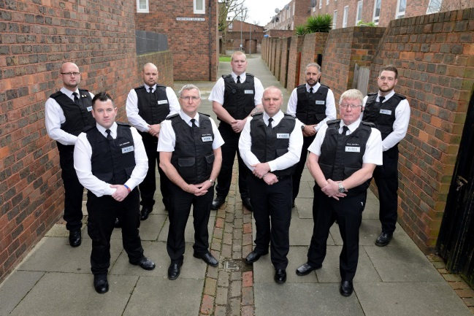
Debunking Myths : Bailiffs , Enforcement Agents here

Slide 4
Debunking Myths : Bailiffs , Enforcement Agents here
Press release
“Body-worn cameras to curb aggressive bailiffs”
“Review of enforcement agent (bailiff) reforms: call for evidence”
“Bailiffs could be forced to wear body-cams when they visit homes and business as MPs bid to crack down on rogue operators”

Slide 5
Debunking Myths : Bailiffs , Enforcement Agents here
Bailiffs
Do Not Exist
Since 2014 they are known as Enforcement Agents .
A certificated enforcement agent is a person appointed under Part 3 of the Tribunals, Courts and Enforcement Act 2007 in England and Wales, who may take control of goods and sell them to pay an amount of money when order to do so by a court. Until 2014, they were known as " certificated bailiffs ".

Slide 6
Debunking Myths : Bailiffs , Enforcement Agents here
Enforcement agents need to be licensed
Do Not Exist !!!
"The Certificated Enforcement Agent (BAILIFF) Register This register holds details of all enforcement agents (previously called bailiffs) who hold a certificate, granted by a judge at the county court, which allows them carry out enforcement action by way of taking control of goods and, if necessary,....

Slide 7
Debunking Myths : Bailiffs , Enforcement Agents here
Level 2 Award
The CICM Level 2 Award in Taking Control of Goods covers the knowledge requirement of those seeking certification to act as an enforcement agent. The qualification tests enforcement law and knowledge about taking control of goods regulations and best practice including understanding about customer care, particularly those in vulnerable circumstance, and conflict management.
Overview
The CICM Level 2 Award in Taking Control of Goods is Ofqual recognised and approved by the Ministry of Justice and Skills for Security to meet the certification requirements of enforcement agents.
Why do I need to take the qualification?
You need to hold a recognised qualification in order to apply for or renew a certificate to act as an enforcement agent (bailiff) under the detailed Regulations issued in 2013 and 2014 of the Tribunals Courts & Enforcement Act 2007.

Slide 8
Debunking Myths : Bailiffs , Enforcement Agents here
What will I learn?
The course covers six areas: The role of an enforcement agent The law surrounding enforcement Taking control of goods Removal and sale of goods Customer care and the national standards Conflict management
What will I gain?
You will gain an award which meets the qualification requirements of enforcement agents. You will need to show this when you apply and renew your enforcement agent (bailiff) certificate.
Who is it for?
Enforcement agents and people associated with enforcement work who require certification from the Ministry of Justice and Skills for Security.

Slide 9
Debunking Myths : Bailiffs , Enforcement Agents here
Without a Certificate an Enforcement Agent cannot Operate and cannot work.
The level of training and skill expectation far outway’s those of a Doorstep debt Collector.
In my World of High Court Writs of Control all Sealed writs are given in the name of Authorised High Court Officers who are responsible for the behavior and actions of the Enforcement officer. If this goes bad authorisation can be removed . Without Authorisation we cannot operate !!
There are 54 Authorised officers in the Country. Gold Dust !!!
We are regulated by the MOJ . Civil Enforcement companies regulated by CIVEA (association) . High Court Officers are also regulation by The High Court Officers Association.

Slide 10
Debunking Myths : Bailiffs , Enforcement Agents here
Why would a Commercial NON Court Enforcement Agent be Instructed.
Recover of Council Tax, Parking /Road Traffic (non criminal ) Fines, Business Rates .enforced by Magistrate Warrants: Civil Enforcement
Recovery of Non FCA Regulated Debts over £600 – High Court Enforcement
Removal of Squatters, Travelers: Either
Commercial Rent Arrears : Either
Commercial Forfeiture : Either
Residential Evictions: High Court

Slide 11
Debunking Myths : Bailiffs , Enforcement Agents here
Enforcement Companies Do Not Want .
Vulnerable Customers referring to us.
Hardship cases referring to us.
Can’t pay cases referring to us
WE WANT WONT PAY CUSTOMERS, WHO CAN PAY, WHERE WE CAN EARN FEES !

Slide 12
Debunking Myths : Bailiffs , Enforcement Agents here
HOWEVER WE ACCEPT THAT DESPITE OUR CLIENTS GREAT EFFORTS TO ENGAGE, CASES DO END UP GOING THROUGH THE LEGAL PROCESS AND NEED ENFORCING.
WE ARE LEGALLY OBLIGED TO ACT
ADDITIONALLY IDENTIFYING VULNERABILITY OR HARDSHIP IS VERY DIFFICULT
BY PHONE, EMAIL AND LETTER. VULNERABLE PEOPLE DO NOT WANT TO ENGAGE.
PEOPLE WHO CALL TO SAY THEY ARE VULNERABLE AND POINT OUT THEY FIT INTO AGREED CRITEREA ARE SELF AWARE .
PEOPLE DO NOT ALWAYS TELL THE TRUTH

Slide 13
Debunking Myths : Bailiffs , Enforcement Agents here
OFTEN THE FIRST INDICATION OF AN ISSUE IS WHEN THE ENFORECEMENT AGENT CALLS

Slide 14
Debunking Myths : Bailiffs , Enforcement Agents here
Vulnerability:
Enforcement agents and internal staff undertake rigorous vulnerability training including
T.E.X.A.S : Think Explain Explicit Consent
B.R.U.C.E : Behavior , Remembering, Understanding, Communicating, Evaluation.
B.LA.KE: Breathe, Listen, Ask , Keep Safe from Arm, End
TCF:, Treating Customers Fairly, Income Expenditure, Common Financial statement.
Most Firms will employ Welfare officers / Vulnerability officers with additional training.
Payment plans , agreed based on the ability to pay, common financial statement, pointing to debt charities Step Change, Christians Against poverty: In line with our clients the Creditors .
“BEING VULNERABLE OR IN FINANCIAL DISTRESS SHOULD NOT AND DOES NOT MEAN THE DEBT IS NOT DUE, SIMPLY THAT A DIFFERENT APPROACH IS REQUIRED”

Slide 15
Debunking Myths : Bailiffs , Enforcement Agents here
Enforcement agents cannot break into peoples houses . Business Yes Private homes No.
Object of Enforcement is to obtain payment/taking control of goods to the effect of or agree a plan plan. Achieve a Positive Outcome .
Taking Control Of Goods is not the first intention but maybe the only way to satisfy the debt.
Nobody owns anything anymore so very rare . ( see fee structure ) in individual debt however Business Debt this can be a good tactic and lucrative !!
Female Enforcement agents are signifanctly more successful , empathy .

Slide 16
Debunking Myths : Bailiffs , Enforcement Agents here
FEE STRUCTURE- HIGH COURT. TAKING CONTROL OF GOODS ACT
Court Fee £66+VAT Recoverable from Debtor
Compliance Stage £75+VAT
First Enforcement Stage £190+VAT plus 7.5% of sum recovered exceeding £1500 ( Recoverable from the Debtor)
Second Enforcement Stage £495+VAT ( Recoverable from the Debtor)
Sale And Disposal Stage £525 + Vat plus 7.5% (Recoverable from the Debtor)
In theory an £750 Judgment for a Water Debt could become £2358!!
HOWEVER REALITY :The vast majority of Individual , non business Debt never goes beyond First Enforcement Stage as the debtor/customer will engage at Compliance or First Enforcement stage .
Out of 4000 cases in 2018 2!! Went to Sale Stage and they both had sports cars !!!

Slide 17
Debunking Myths : Bailiffs , Enforcement Agents here
BEHAVIOUR, COMPLAINTS, FUTURE
Have agents made mistakes ? Of course no matter what training is given we are dealing with human beings.
Enforcement agents are human and may themselves suffer financially this is when corners may be cut.
Self Employed against employed?
Certification ( must be)
Established Firms, bigger often does mean better. ( Training Resource)

Slide 18
Debunking Myths : Bailiffs , Enforcement Agents here
BEHAVIOUR, COMPLAINTS, FUTURE
Body Worn Cameras will become compulsory to protect both parties . However this is not the Panacea. GDPR minefield and we are asked to switch cameras off.
Self Regulation will end. We have CIVEA . High Court Association and MOJ light touch . Its not healthy and means the industry is open to criticism however any new regulator will need funding who pays ?
Court Reforms may mean FCA Enforcement is Privatised . We could see two distinct set of rules almost like PAP . Consumer all regulated by FCA and Business Debt MOJ?
Lets see.
Any Questions

