Slide 1
Welcome

Slide 2
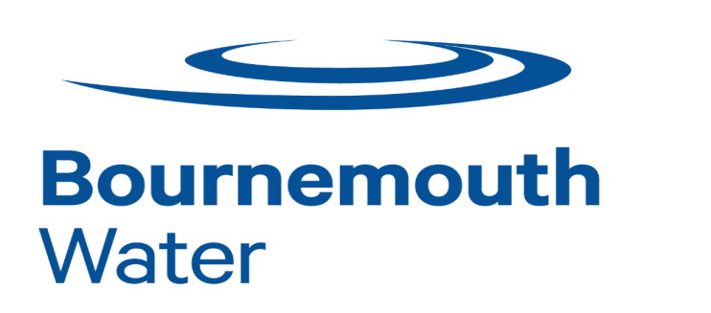
Who we are
Notes:
WHO WE ARE – OVERVIEW OF GROUP COMPANIES
As you will see from this image, South West Water is part Pennon Group plc based in Exeter. Pennon Group is listed on the London Stock Exchange.
South West Water is licensed to provide, since the industry was privatised in 1989, water and sewerage services to customers in Devon, Cornwall and small areas of Dorset and Somerset.
Our sister company, Viridor, based in Taunton, is one of the UK’s leading recycling, renewable energy and waste management companies. Although their headquarters are in Somerset, they have landfill sites and recycling stations all over the UK, and work with more than 90 local authorities and thousands of private customers. country.

Slide 3
As one of the largest environmental infrastructure groups in the UK, Pennon is at the top end of the FTSE 250, has assets of around £6.2 billion and a workforce of around 5,000 people.
Pennon currently own South West Water, Bournemouth Water, Pennon Water Services and Viridor Water management
On 15 April 2015 Pennon acquired Bournemouth Water, a top performing water company which is an excellent fit with South West Water. The acquisition has expanded South West Water’s wholesale capabilities and provides an enhanced platform for innovation and growth

Slide 4
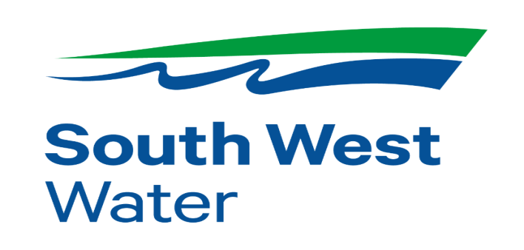

Slide 5
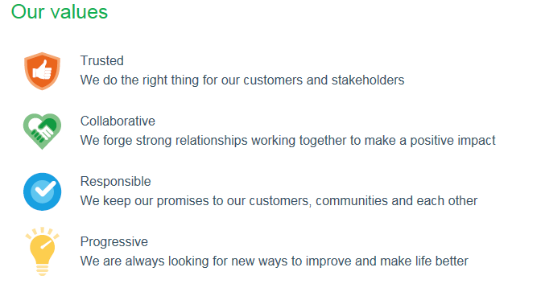

Slide 7
Why are we here Today
Lead a more proactive role in helping to understand our customers needs by getting a full holistic view of what’s happening in other businesses, regulators and debt advice services across the country.
Help us to deliver better customer outcomes and provide us with informed solutions to challenges we face in achieving this.
Have honest conversations both with businesses and with debt advice agencies about working together and by doing so influence real change when dealing with vulnerable customers.
Network with various individuals and groups to build relationships in the South West Region.

