Slide 1
Tackling problem debt
Rich Sullivan-Jones and Ivan O’Brien
National Audit Office
7 February 2019

Slide 2
Structure
1. The NAO
Our role
Our value for money (VFM) work
2. Report overview
Background
VFM Conclusions
3. Key findings
Identifying the problem and coordinating the approach
Preventing over-indebtedness
Managing problem debt
4. Questions for group discussions

Slide 3
The NAO

Slide 4
Our role
The National Audit Office (NAO) scrutinises public spending for Parliament
We help to hold government departments and other public bodies to account for how they use public money or deliver public policy
Our work helps public service managers to improve performance and service delivery, nationally and locally

Slide 5
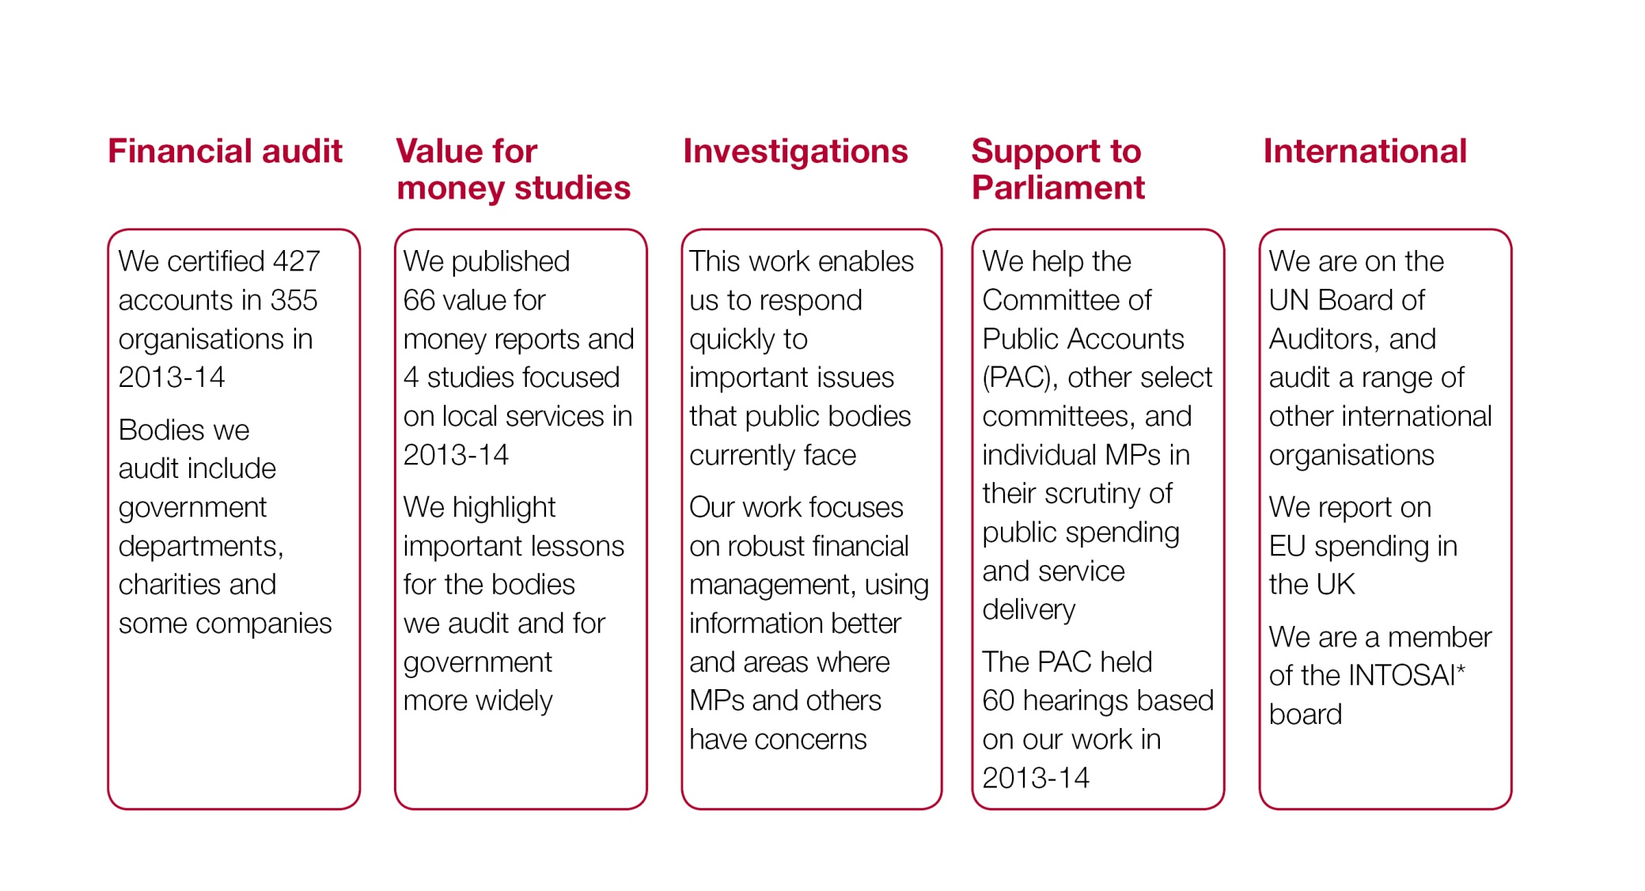
There are five dimensions to our work
* International Organisation of Supreme Audit Institutions

Slide 6
Our VFM work
Through our Value-for-Money (VfM) work, we report on the economy, efficiency and effectiveness with which public sector bodies use public money
National Audit Act 1983 gives statutory access & reporting rights
~ 60 published outputs a year; most heard by the Committee of Public Accounts (PAC)
We do not comment on the merits of policy objectives, but aim to conclude on whether value for money has been secured
Our public audit perspective helps Parliament hold government to account and improve public services. It leads to savings and other efficiency gains: £741 million of agreed, audited savings in 2017-18

Slide 7
Tackling problem debt: report overview

Slide 8
Background
On 6 September 2018 we published our report on Tackling problem debt. The report aims to evaluate and conclude on HMT's overall approach to over-indebtedness, and how well it brings together government's and other stakeholders' various activities and interventions to meet its objectives. In particular, the report examines:
Whether HMT has appropriate mechanisms to identify the scale and nature of the problem it is seeking to address and organise government's response
Evidence on the effectiveness and coordination of government actions to prevent problem debt through improving people's financial capability and regulating consumer credit lending
The extent to which government as a whole adopts best practice in managing its own debtors, and supports over-indebted people more generally through debt advice and other protections

Slide 9
VFM conclusions
HMT is taking a thoughtful and well-intentioned approach to excessive indebtedness. It recognises that this has significant damaging effects in terms of public and economic costs, as well as on individuals, although these are not quantified. The effort to provide support across multiple government actors has become more coherent in recent years.
However, the problem has not stood still. Utility providers and the public sector have emerged as major components of debt problems. The information available in these areas is, disappointingly, much less coherent or transparent than commercial debt information. There are also crucial areas, such as debt collection, where public oversight lacks impact. While recognising the positives, we conclude that HMT cannot promote improvement in the management of excessive debt as effectively as possible across a wide network without fixing the weak links. This leads us to assess that there is further to go before value for money is secured.

Slide 10
Identifying the problem and coordinating the approach

Slide 11
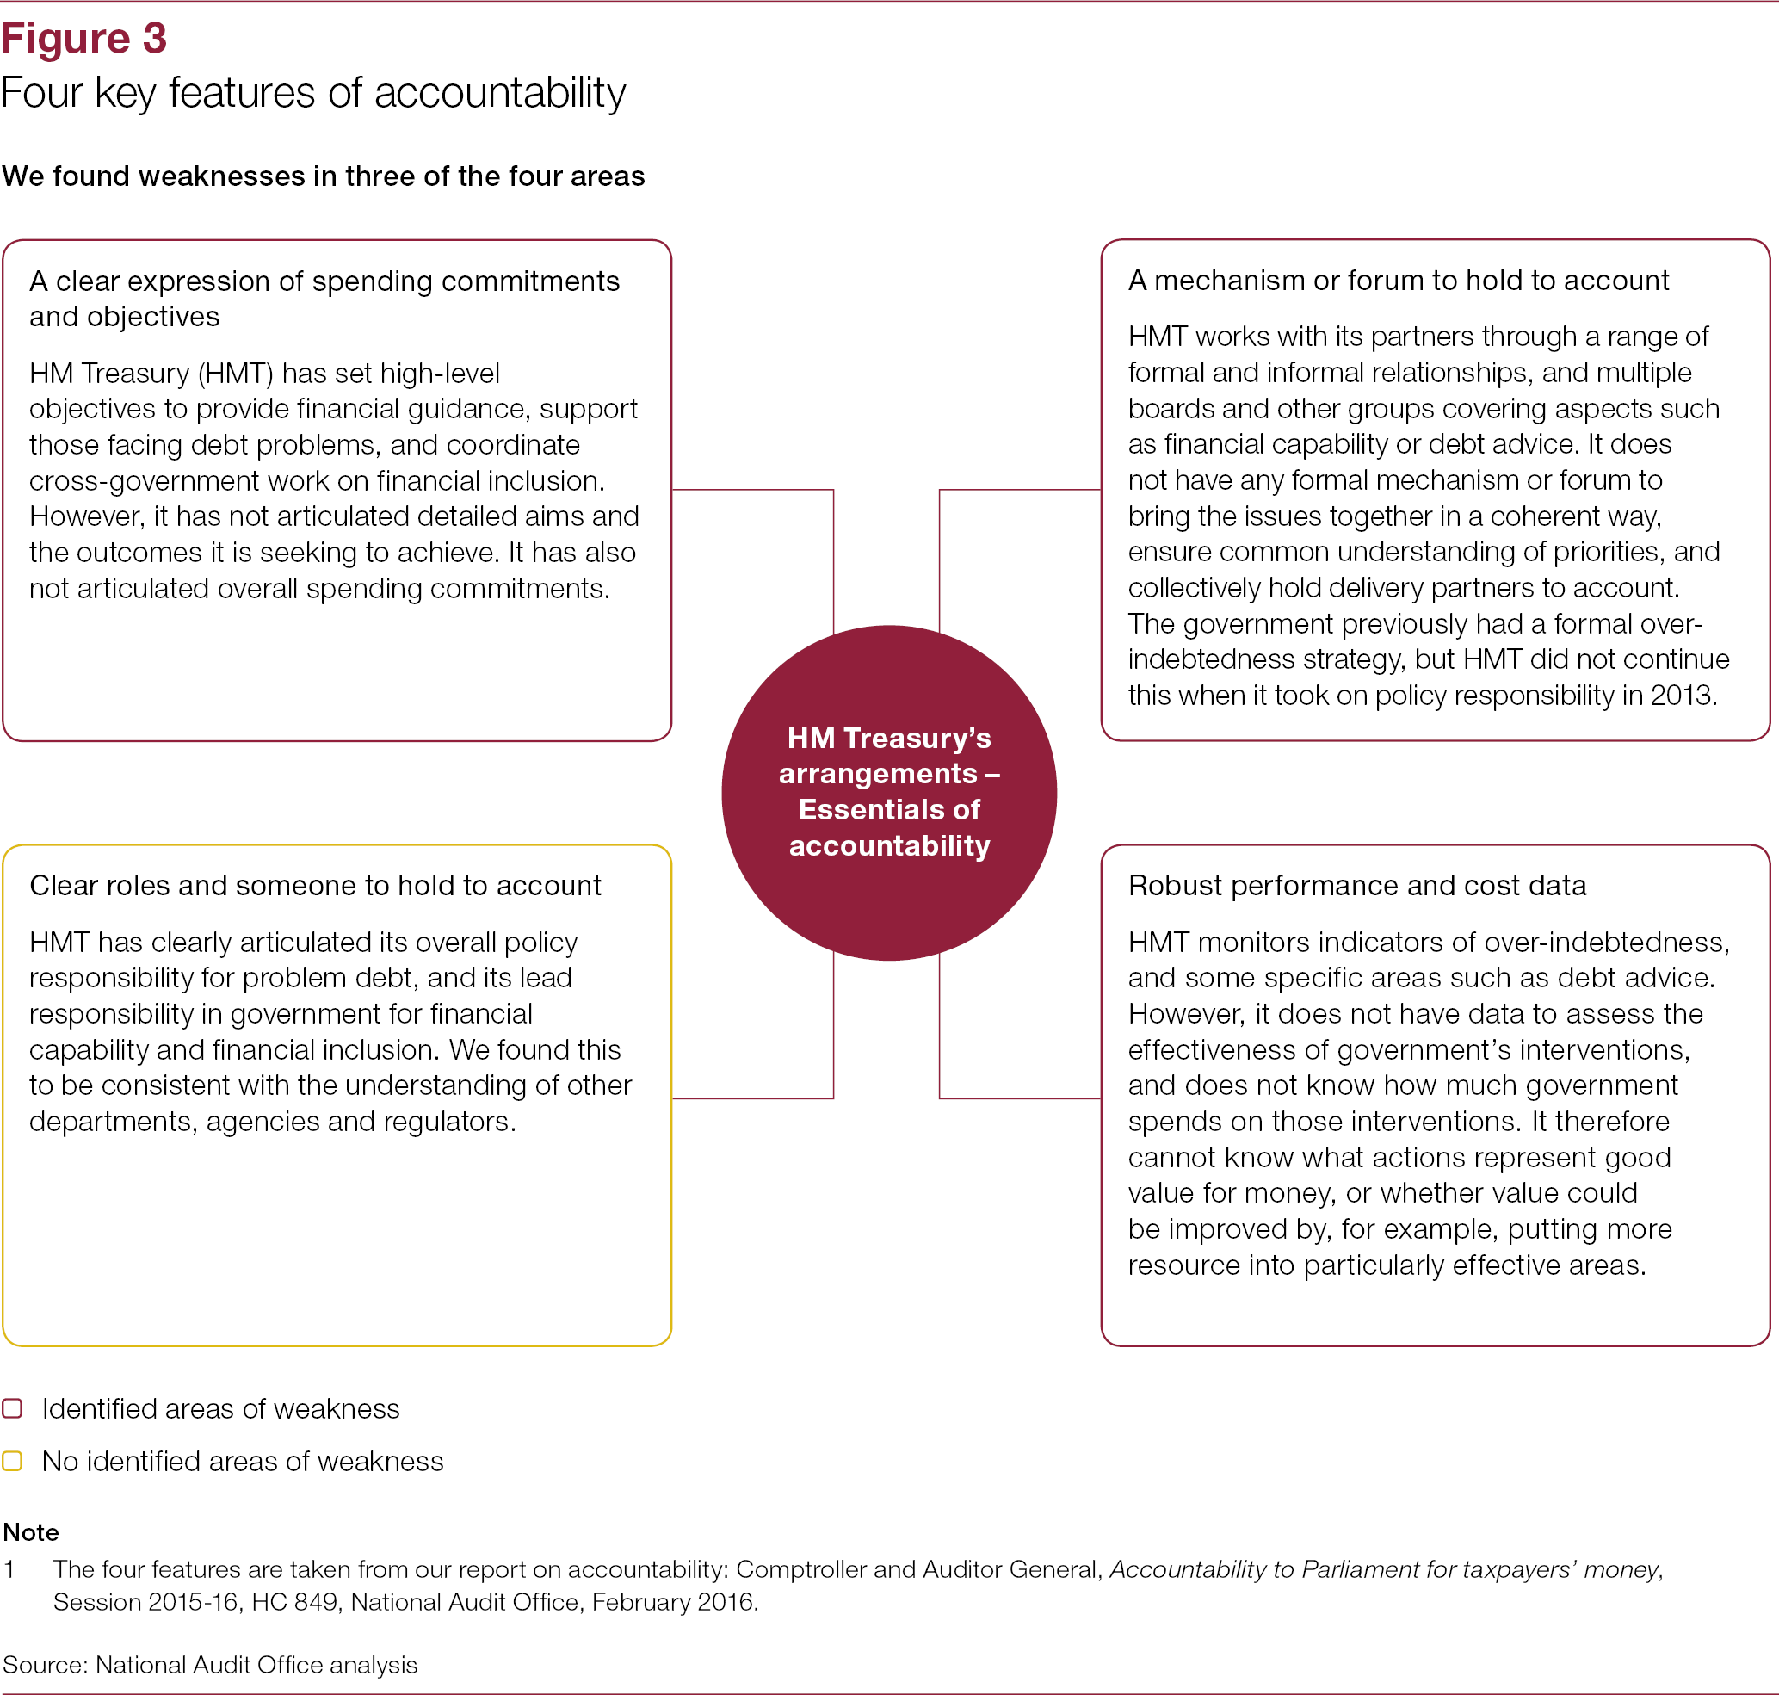
HMT relies on many organisations to meet its objectives on problem debt, but there are weaknesses in its accountability arrangements for ensuring there is an effective and coherent approach.

Slide 12
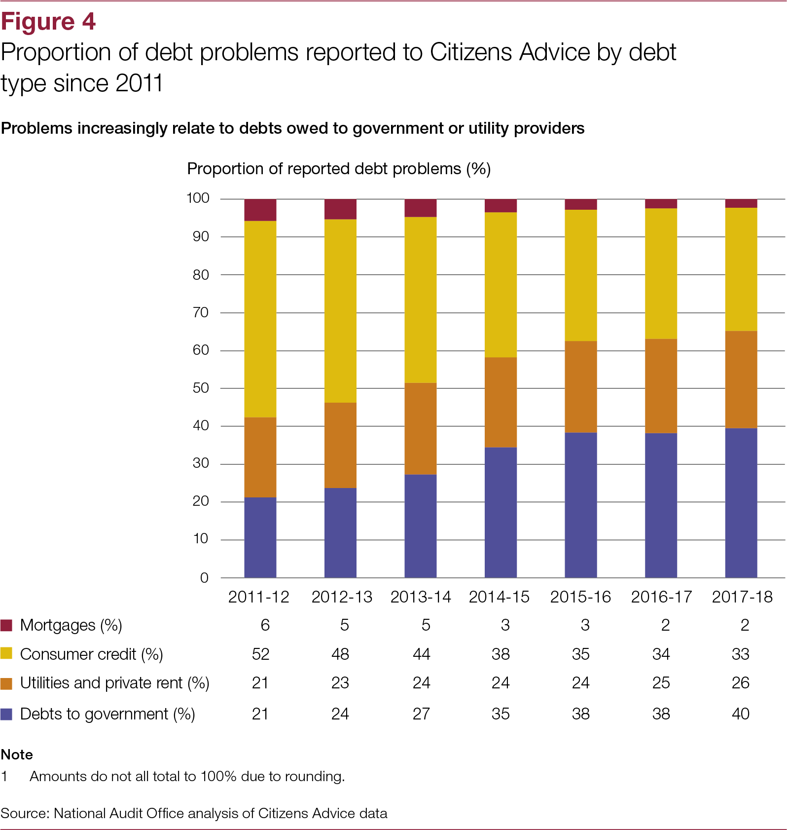
People increasingly report problems with debts owed to government or utility providers, but HMT has limited insight into these areas.
Government has less detailed insight into debts in other private and public sectors compared with consumer credit and mortgages, and it does not accurately know the overall level of outstanding personal debt.
Not all departments, agencies and regulators collect data on personal debts.

Slide 13
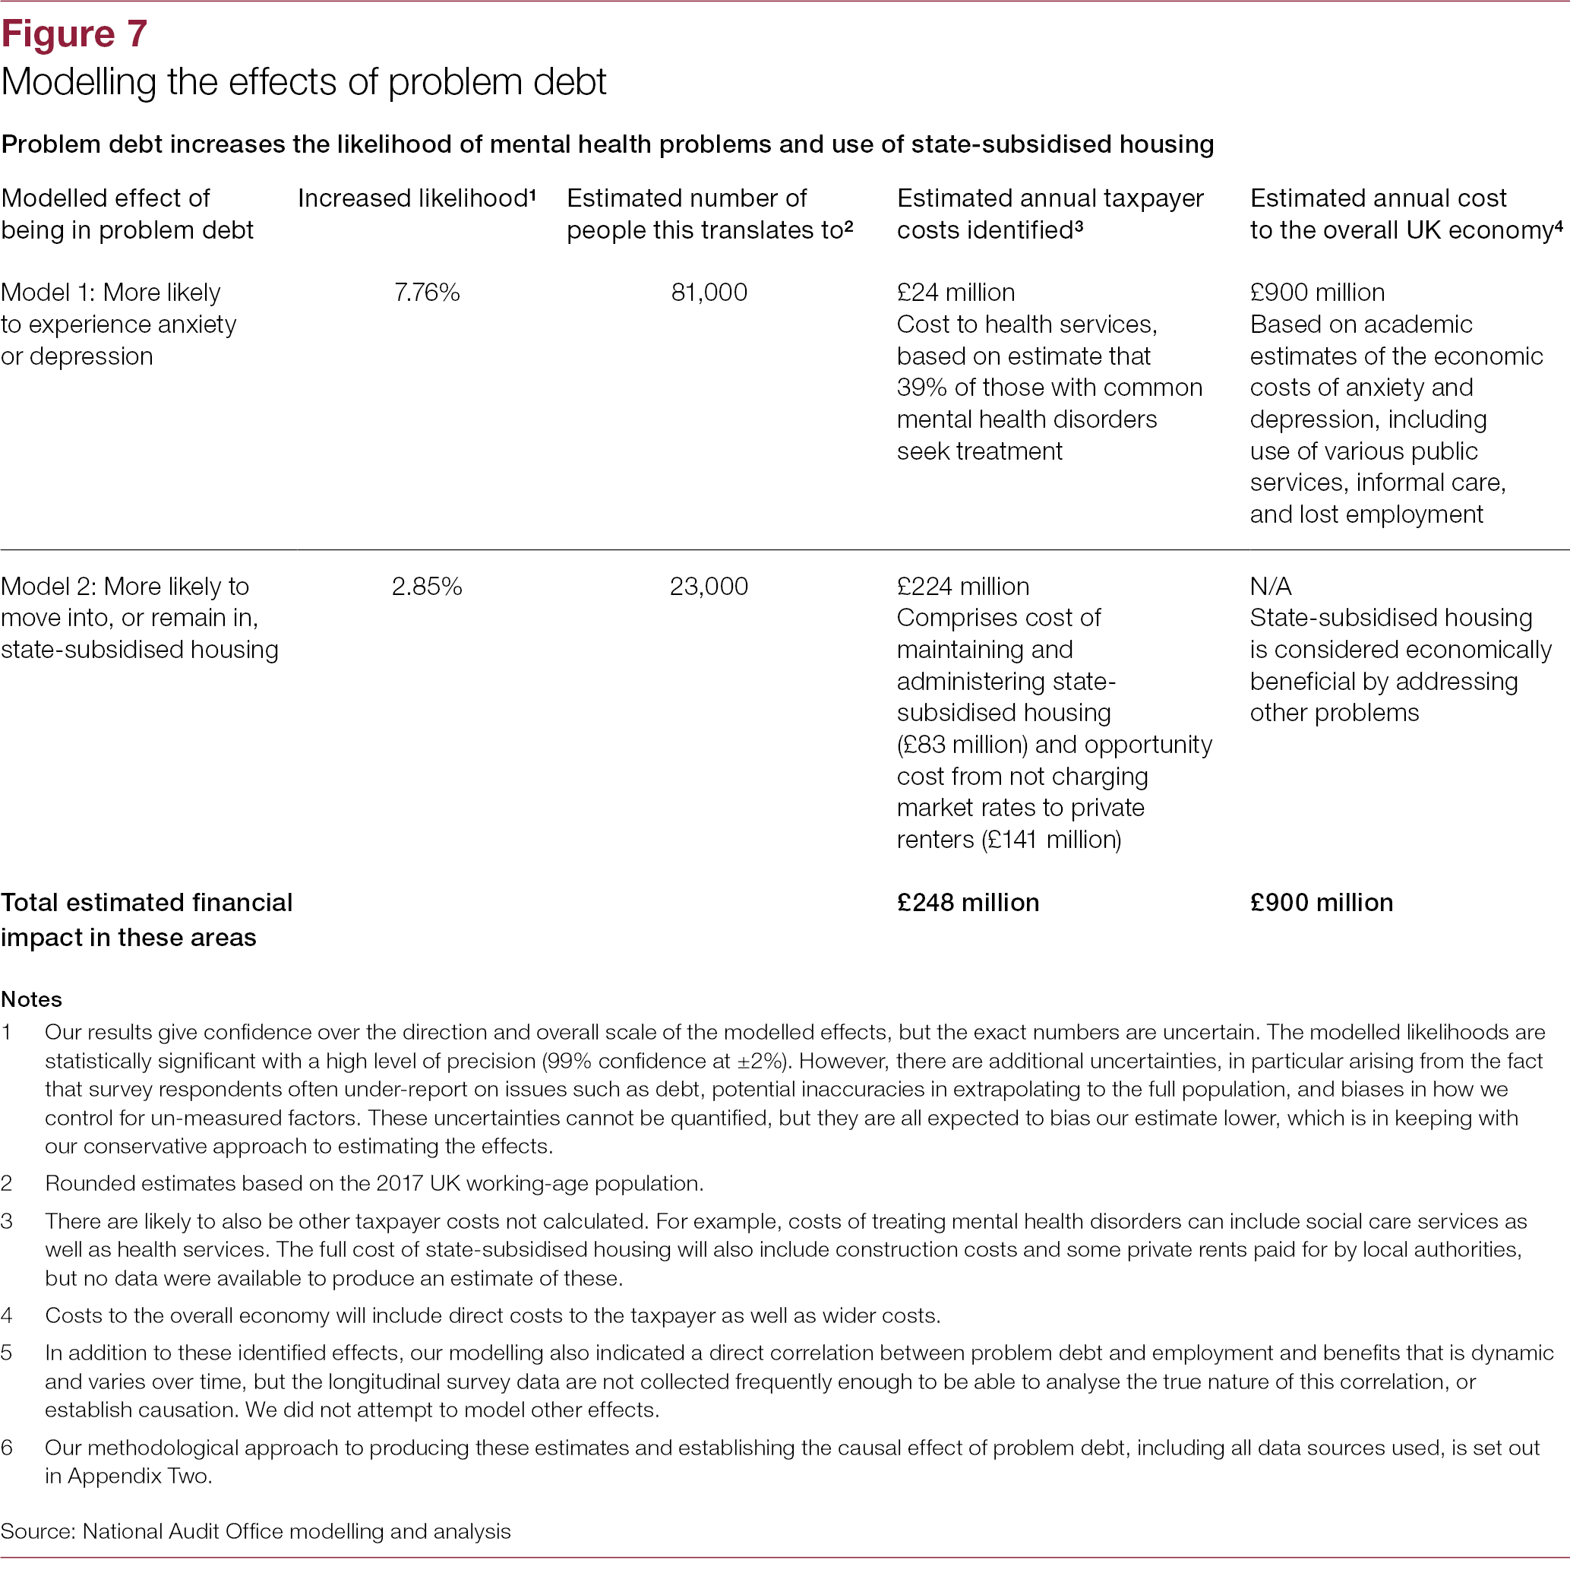
Government has no estimate of the extent to which problem debt leads to increased use of public services, or the resulting cost to the taxpayer.
Understanding these costs is important for policymakers in considering the impact of policy design on over-indebtedness.
We modelled national survey data to produce our own estimates.

Slide 14
Preventing over-indebtedness

Slide 15
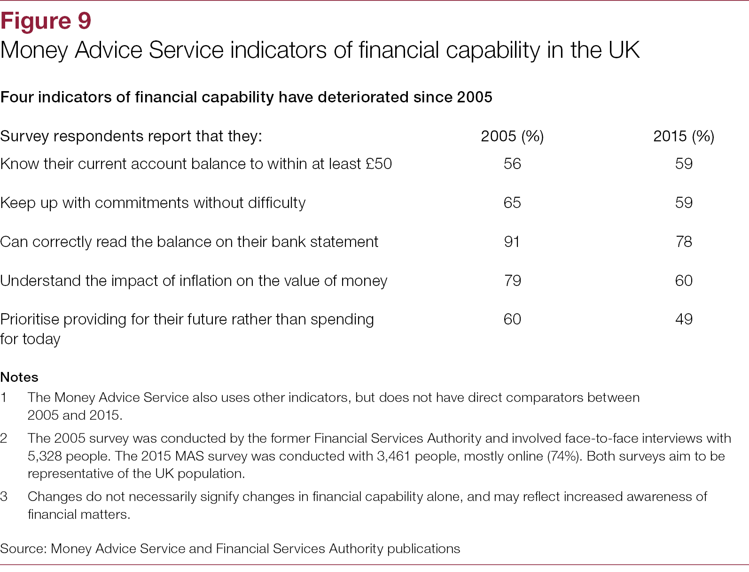
MAS has improved coordination of interventions to raise individuals' financial capability, but its strategy does not involve all relevant parts of government and MAS does not yet know the strategy's impact.
MAS has improved coordination of interventions to raise individuals' financial capability, but its strategy does not involve all relevant parts of government and MAS does not yet know the strategy's impact.
Research from MAS and the OECD suggest financial capability in the UK is low, and below average among OECD countries.

Slide 16
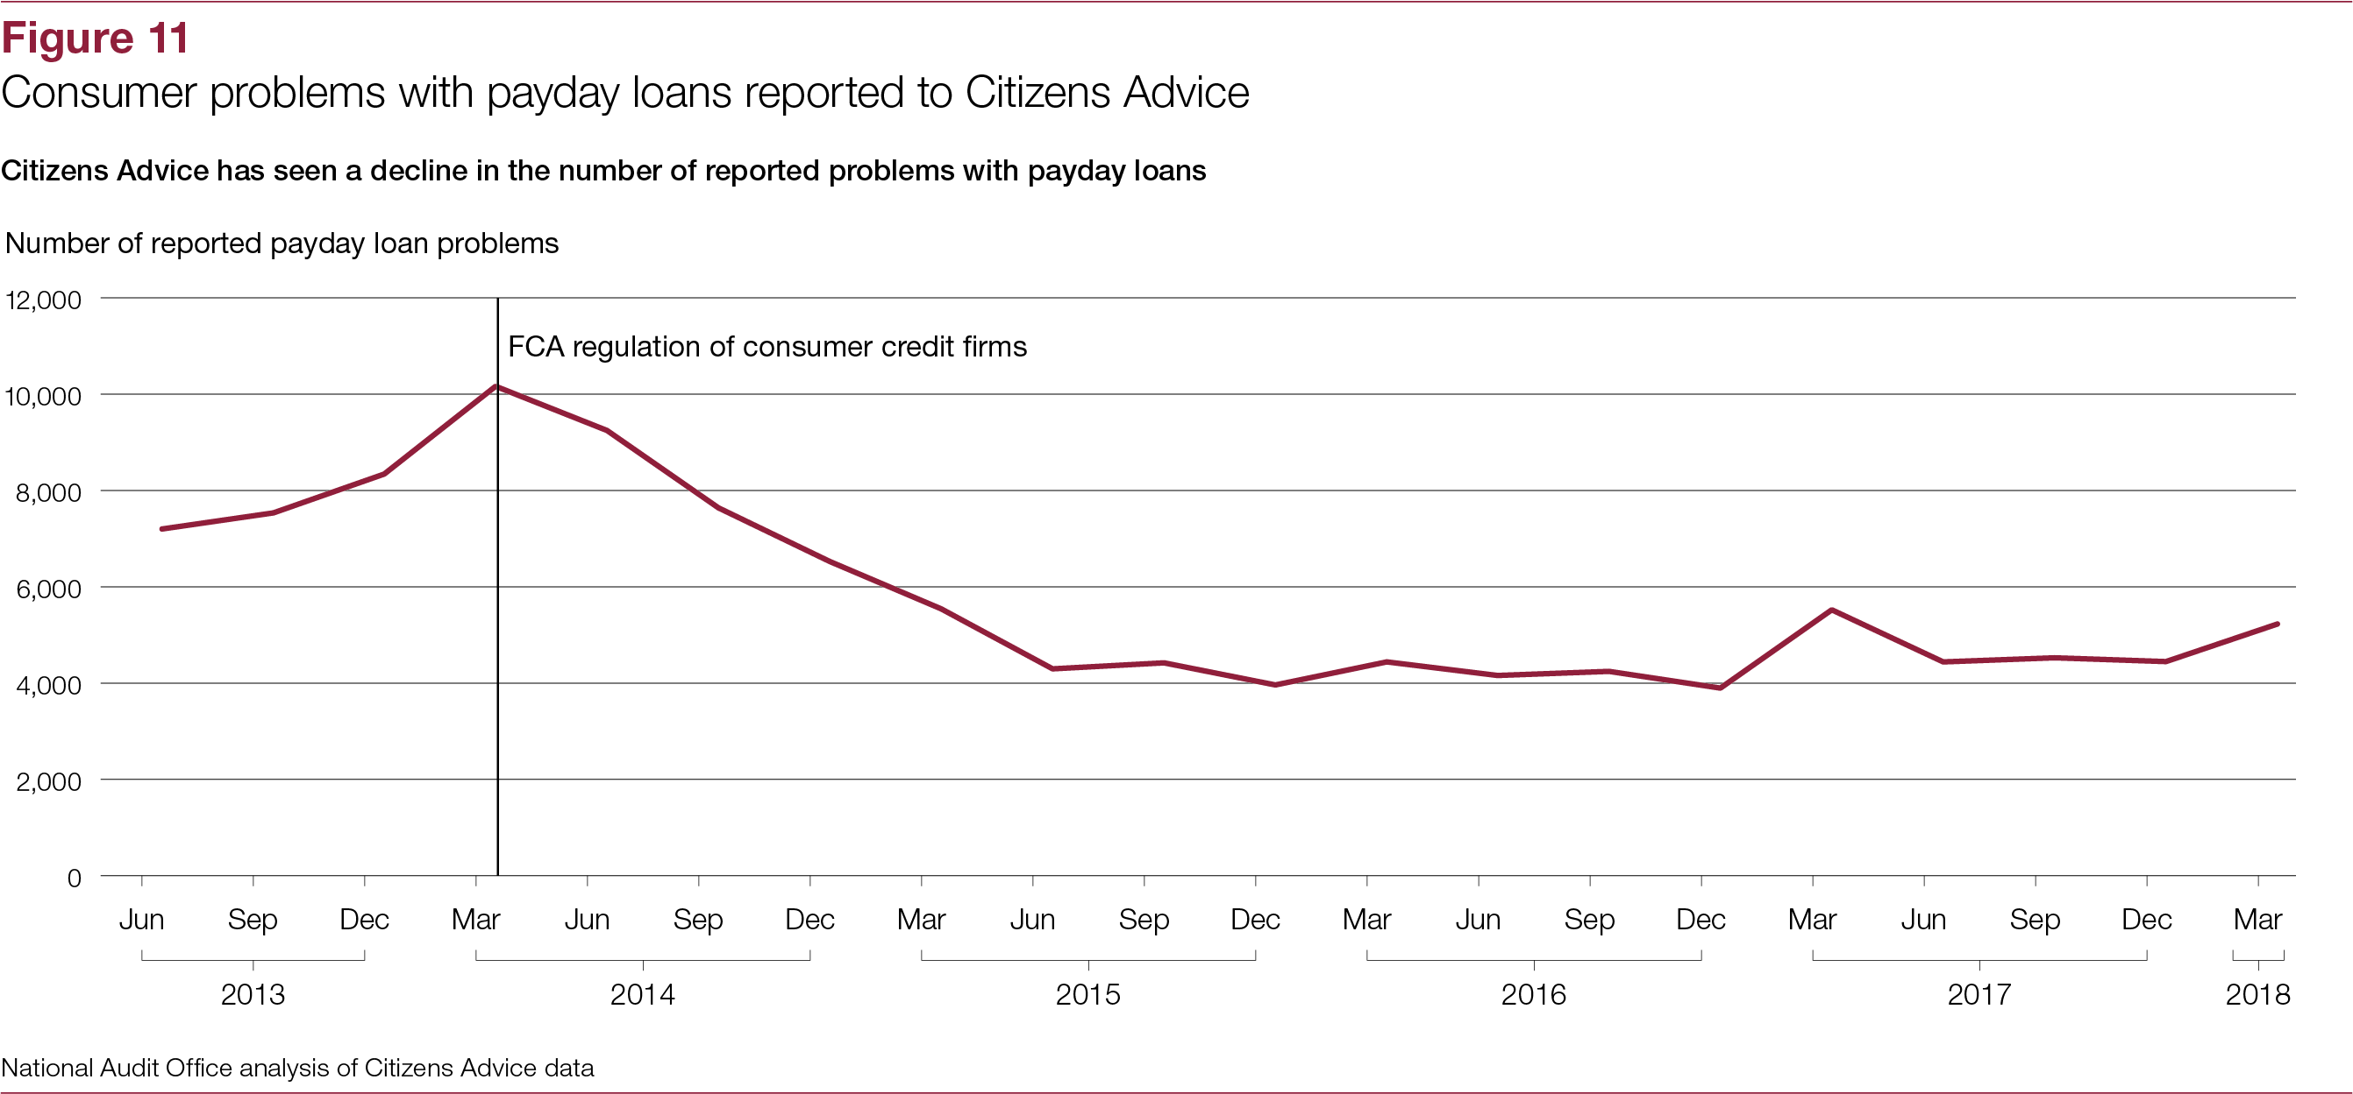
The FCA has taken action to improve responsible lending, but recognises that it has more to do to tackle persistent and unsustainable consumer credit debt.
Many people, including the poorest in society, will struggle to afford services regardless of how well they manage their money. Government therefore seeks to prevent people getting over-indebted by ensuring that service providers consider what their customers can afford. Affordability is a particular concern in unsecured consumer credit, where debt levels can escalate quickly due to high interest rates.

Slide 17
Managing problem debt

Slide 18
Evidence shows that good debt collection practice both benefits individuals and boosts collection rates.
Common best practice principles include timely assessments of vulnerabilities, affordable repayment plans, and signposting or referring people to debt advice.
Research in 2014 estimated that tailored debt advice, support and affordable repayments saved creditors £82 million in a year from 110,000 over-indebted clients, an average saving of £750 per person.
Lenders and debt collection agencies we interviewed also reported benefits from following best practice.
By comparison, our modelling, based on a survey of debt advice clients, estimates that intimidating actions and additional charges were 15%–29% more likely to make debts harder to manage and increase levels of anxiety or depression.

Slide 19
Barriers to adoption of good practice in government:
1. A lack of data sharing
The Committee of Public Accounts' 2014 report on managing debt owed to central government found that departments lacked the information necessary to target collection activities, and recommended developing a single view of what each debtor owes to government as a whole.
There are legal barriers to sharing personal data between organisations. Furthermore, not all departments can disaggregate all debts owed by individuals from debts owed by organisations.
The Cabinet Office developed data-sharing legislation through the Digital Economy Act 2017, which includes new powers that allow specified public authorities to pilot data-sharing for specific purposes and with appropriate safeguards.

Slide 20
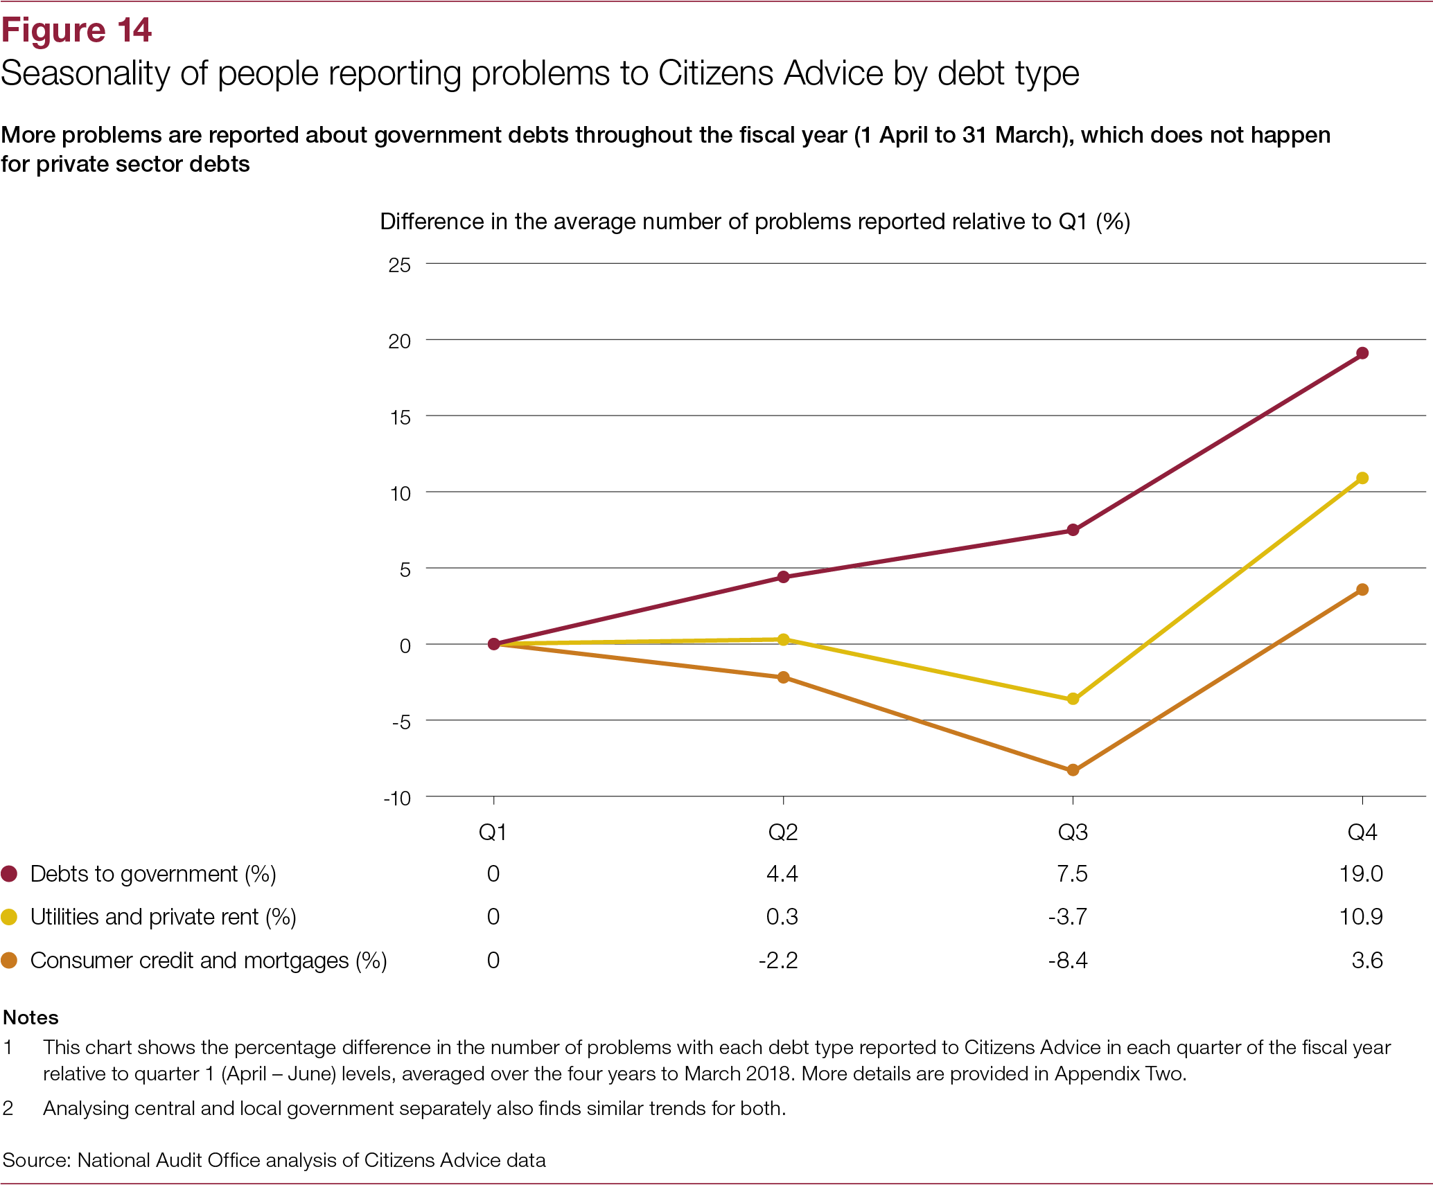
Barriers to adoption of good practice in government:
2. Short-term incentives and funding pressures
People report more problems with debts owed to government as the fiscal year progresses. This pattern is not observed with private sector debts.
Stakeholders we interviewed considered that this could be affected by short-term incentives (in-year collection targets and league tables) and local funding pressures creating a greater demand to pursue debts more quickly and aggressively.

Slide 21
Strengthening statutory protections and a shortfall in debt advice
Following manifesto commitments in the 2017 election, HMT announced the Breathing Space scheme and Statutory Repayment Plan for people who have problem debt. Success will depend on the extent to which the new protections are used and the impact they have on outcomes, which HMT recognises it will need to consider when designing the scheme.
MAS commissioned an independent review of debt advice funding which highlighted there is a shortfall in the current level of provision, with an estimated 600,000 over-indebted individuals unable to access advice. To satisfy future demand, the review recommended that the amount of free debt advice available needs to rise by 50% within two years.

Slide 22
Questions for group discussion
Three groups, to discuss one question each. We will have around 25 minutes to discuss the question and capture our thoughts, after which we will each feed back to the other groups.
What can be done to improve the quality and availability of data on the scale, nature and impact of problem debt?
What are the three main barriers to preventing problem debt from occurring in the first place, and how might we overcome them?
What can public sector creditors learn from private sector creditors and the debt advice sector about good debt collection practice, and how can we facilitate this?

